Slide 1
REAL TIME INDUSTRIAL MANAGEMENT SYSTEM

Slide 2
INTRODUCTION
Real time industrial monitoring system (RTIMS) is monitoring the whole industrial machines and devices. we are going to innovate some futuristic things like tracking the whole goods and products , finding the accidental errors before the major accidents happens and automatically fix that type of problem.
Using some algorithm and machine learning (Ml) this types of errors all fix it. using artificial intelligence the real time errors and tracking systems are controlled which is also monitor with more accuracy.

Slide 3
Real time monitoring data's and errors all stored in cloud storage and if any accidental errors is founded in any devices or machines then the emergency signal sends to the main controllers. which can monitor and control the power system of machines to.
IOT is the main root of this system and some mobile app is we going to develop to monitor the systems. we are gathering some more ideas to build this type of system very futuristic.

Slide 4
ABSTRACT
There are some industrial maintenance deficiency which is taken as statistics

Slide 5
The major deficiency is unfollowing the proper inspection due to this types of defect the major accident happen and also some error like quality checks, arithmetic error, human error, interface defects and performance defects.
Using ARTIFICIAL INTELLIGENCE we can fix this types of errors.
If it is major defect then emergency signal sends to the supervisor before accident happen.
it can monitor the power supply of each machines and devices, if any problem in power supply then it can shut down the power to defected machines and sends an alert to supervisor, he can also control the machines via mobile app.

Slide 6
BLOCK DIAGRAM OF RTIMS
POWER SUPPLY
LCD
A
D
C
MICROPROCESSOR
GSM MODULE
SENSORS
server
cloud
CONTROL SYSTEM
MOBILE APP
COMPUTER

Slide 7
MICROPROCESSOR:
Atmega 128:The high-performance, low-power Microchip 8-bit AVR RISC-based microcontroller combines 128KB of programmable flash memory, 4KB SRAM, a 4KB EEPROM, an 8-channel 10-bit A/D converter, and a JTAG interface for on-chip debugging. The device supports throughput of 16 MIPS at 16 MHz and operates between 4.5-5.5 volts.By executing instructions in a single clock cycle, the device achieves throughputs approaching 1 MIPS per MHz, balancing power consumption and processing speed.
STM32:The STM32 family of 32-bit microcontrollers based on the Arm® Cortex®-M processor is designed to offer new degrees of freedom to MCU users. It offers products combining very high performance, real-time capabilities, digital signal processing, and low-power and low-voltage operation, and connectivity, while maintaining full integration and ease of development.The unparalleled and large range of STM32 microcontrollers, based on an industry-standard core and accompanied by a vast choice of tools and software, makes this family of products the ideal choice, both for small projects or an entire platforms. using for artificial intelligance implement with neural network.

Slide 8
SENSORS:
Device that detects the changes in electrical or physical or other quantities and thereby produces an output as an acknowledgement of change in the quantity is called as a Sensor. Generally, this sensor output will be in the form of electrical or optical signal. e.g: Temperature sensor, humidity sensor, pressure sensor, chemical sensor, vibration sensor, voltage sensor, position sensors and magnetic sensor.
GSM MODULE:
This is an ultra compact and reliable wireless module. The SIM900A is a complete Dual-band GSM/GPRS solution in a SMT module which can be embedded in the customer applications allowing you to benefit from small dimensions and cost-effective solutions.Featuring an industry-standard interface, the SIM900A delivers GSM/GPRS 900/1800MHz performance for voice, SMS, Data, and Fax in a small form factor and with low power consumption.

Slide 9
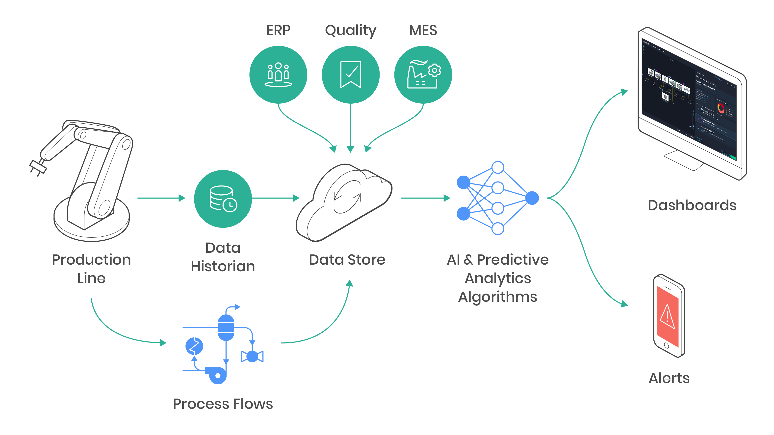
INTERNET OF THINGS:
IOT is an main impact in RTIMS because this things only used to store the data and send the data.
data was stored in cloud and also monitor in dashboard of the system.
if any emergency then the alert message sends to the operaters and supervisors.

Slide 10
ADVANTAGES:
Real-time production level notifications
Live feedback of machines performance data
Find and fix repetitive problems
Reduce errors
DISADVANTAGES:
Any failure or bug in the software or hardware will have serious consequences.
Expensive of cost

Slide 11
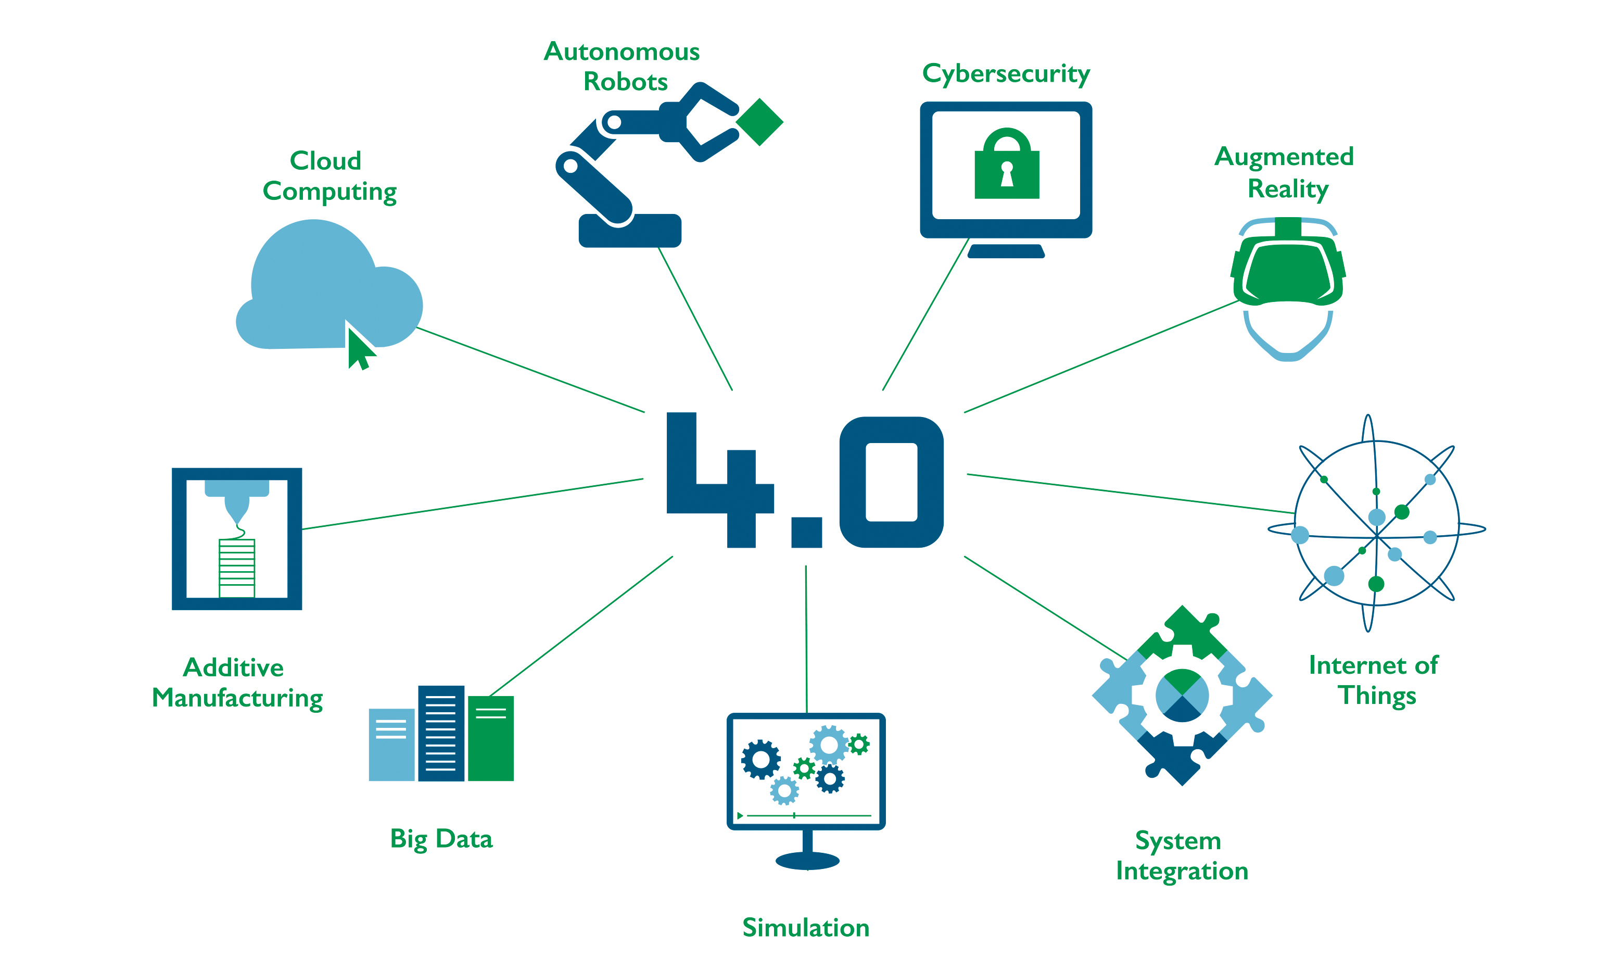
CONCLUSION:
This real time industrial monitoring system is having a continuos monitoring and controling over there condition of work. which is mainly implemented for industry 4.0 and also this type of technology over come for the peoples community too.

